Slide 1


GAS LEAK DETECTION SYSTEM
Ammirthakadeswar V
Arvind M
Ramanuja Nambi K
23BEC011
23BEC021
23BEC141

Slide 2
OBJECTIVE
Detect the presence of hazardous gases (e.g., LPG, Methane, CO).
Provide early warning using buzzer
Display gas concentration level on LCD/serial monitor.
Send alert notification (IoT based/Node-RED).
Ensure low-cost, reliable, and real-time monitoring.
LITERATURE SURVEY
Traditional systems: Basic gas alarms without digital monitoring.
Modern systems: IoT-enabled sensors for remote detection.
Widely used sensors: MQ-series (MQ-2, MQ-6, MQ-7, etc.).
Gap: Many existing systems lack portability, cost-effectiveness, or IoT integration.

Slide 3
IMPLEMENTATION
1. Sensor Module – Use MQ-2 sensor for gas detection.
2. Microcontroller – ESP32 for processing.
3. Alert System – Buzzer for immediate alerts.
4. Display – LCD or serial monitor to show gas levels.
5. Communication –Node-RED for remote SMS/IoT alerts.
6. Testing – Simulate sensor response with small controlled gas exposure.

Slide 4
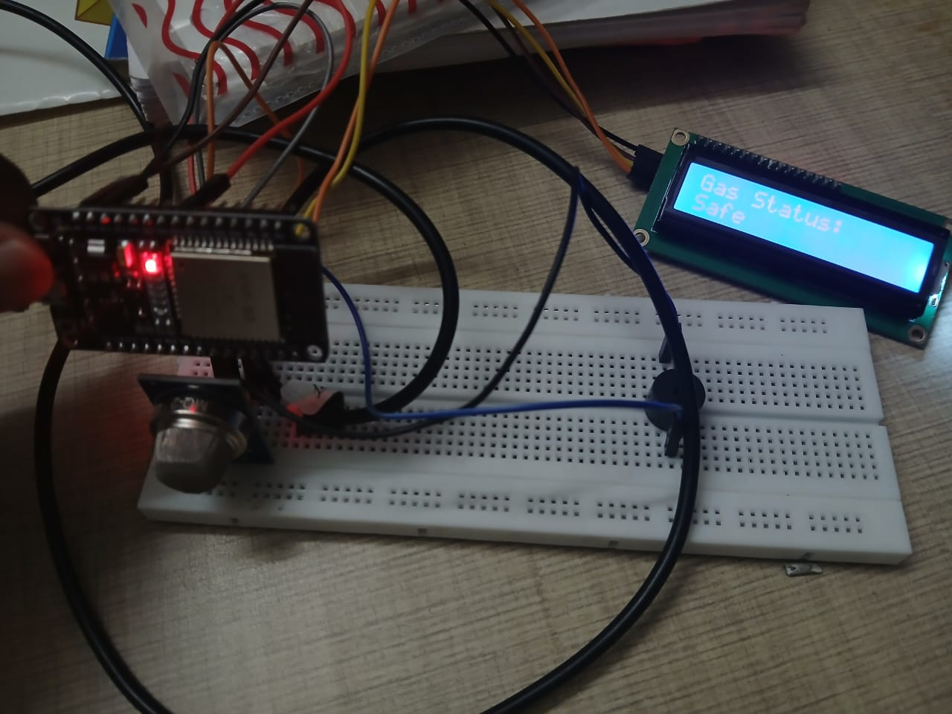
CIRCUIT DIAGRAM

Slide 5
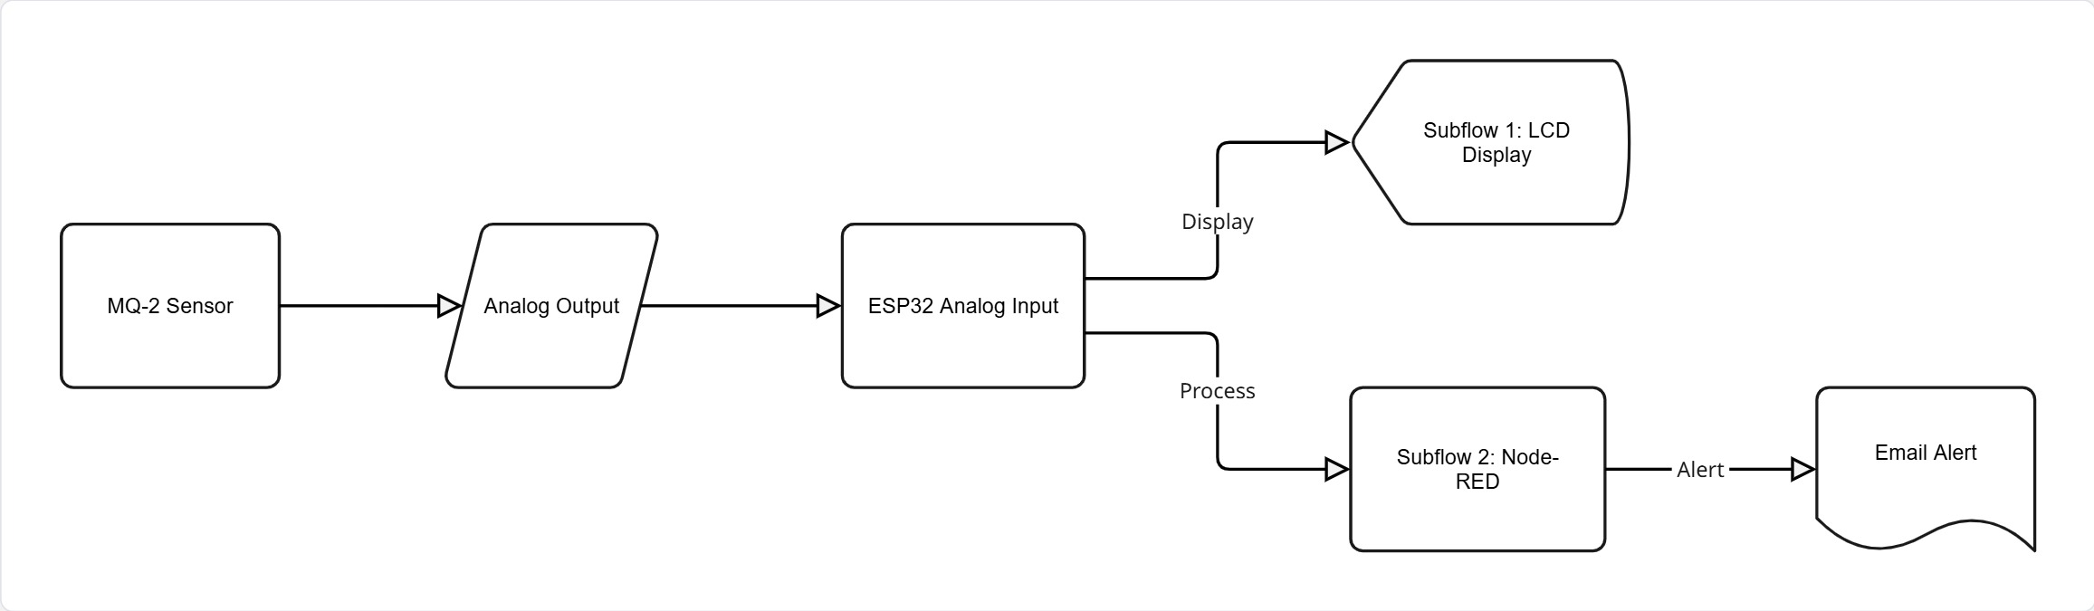
BLOCK DIAGRAM

Slide 6
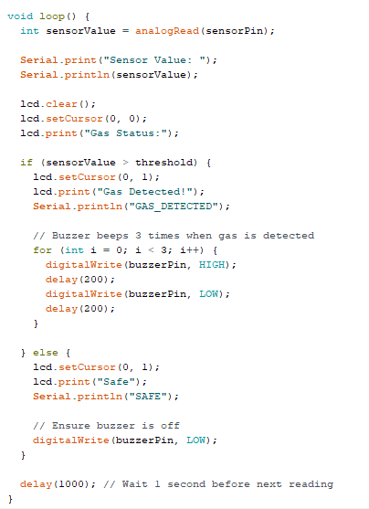
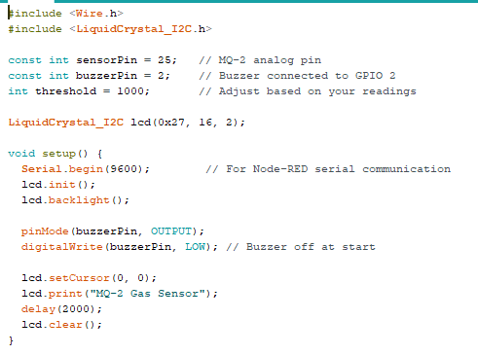
ESP-32 PROGRAM

Slide 7
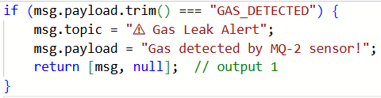
NODE-RED JS Message Function

Slide 8
THANK YOU

